Slide 1
Hospitalization Prediction

Slide 2
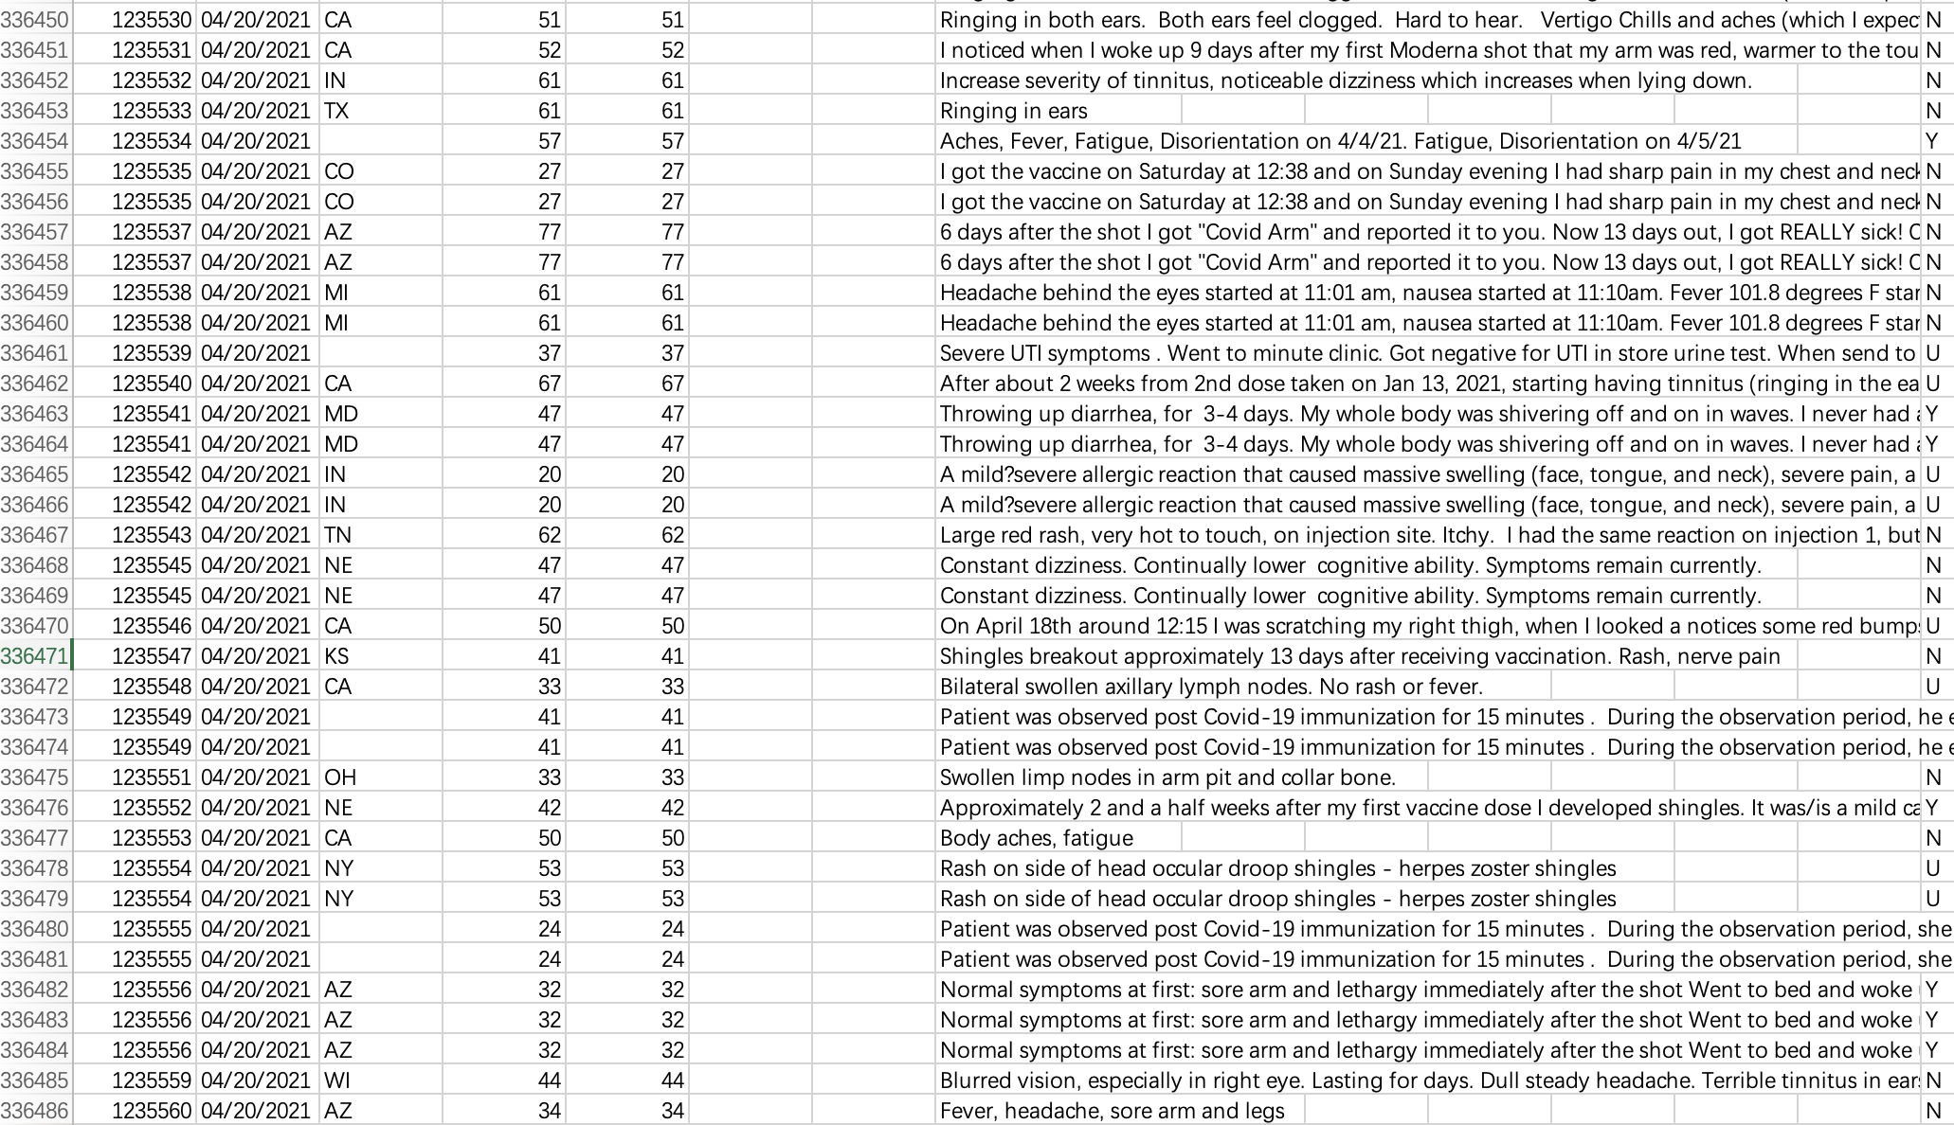
In our dataset, from January 1, 2021, to April 20, 2021, a total of 245,908 persons reported adverse events in the VAERS system producing 336,486 adverse events.
Notes:
In this part, our main task is to use machine learning approaches to classify the patients with needs for hospitalization for treatment after COVID-19 vaccination and find the significant symptoms. Firstly Let's look at the dataset.

Slide 3
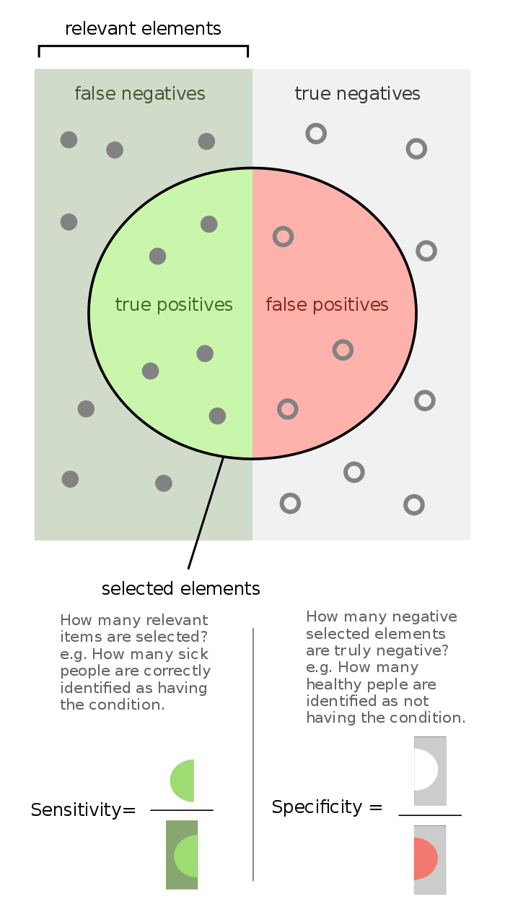
Firstly, there are 6725 unique symptoms. However, on average each patient only self-reported 5 symptoms resulting in a high dimensional and highly sparse input feature matrix.
Secondly, since most patients with self-reported adverse effects do not need hospitalization, the output labels are highly imbalanced. Even if we predicted all the outcomes as no need for hospitalization, the accuracy can still be up to 95%.
Sensitivity = Recall = TP/P = TP/(TP+FN)
Specificity = TN/N = TN/(TN+FP)
Notes:
So with the dataset, when we want to find the significant symptoms that cause hospitalization. Here coms two difficulties.
In the experient, we use the sensitivity and specificity to value our method, because these two metrics are common evaluation criteria in a clinical setting.
what we called zero probability problem

Slide 4
Sparse PCA
Naive Bayes
To solve the problem of high dimensional sparse features, we used sparse PCA to reduce the dimensionality of features from 6725 to 5 or 10.
Then we used the transformation to obtain the low dimensional features of all training set samples, and logistic regression with balanced class weights to compute the risk of hospitalization.
To tackle the zero-probability problem, we used Naïve Bayes classifier with sparse constraint for the Bernoulli distribution model and Laplace smoothing.
The risk of hospitalization is then computed. And the significant symptoms are selected according to the posterior probabilities.
Notes:
our focus was the significant symptoms that would lead to patients' needs for hospitalization, we only used the symptoms reported by patients with the need for hospitalization to obtain the principal components.
we used the transformation to obtain the low dimensional features of all training set samples, and logistic regression with balanced class weights to compute the risk of hospitalization.

Slide 5
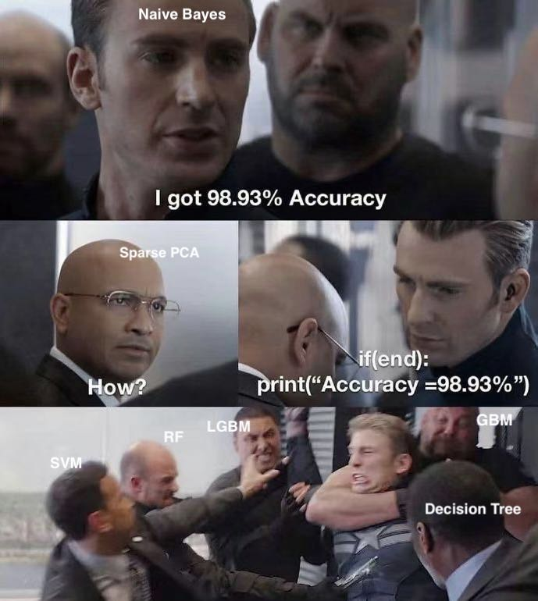
Results

Slide 6
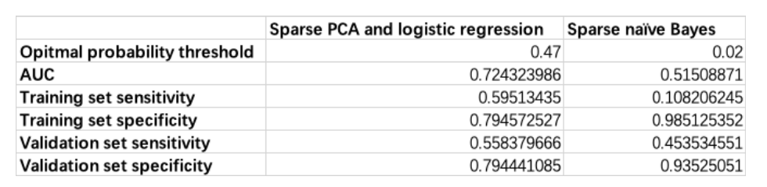
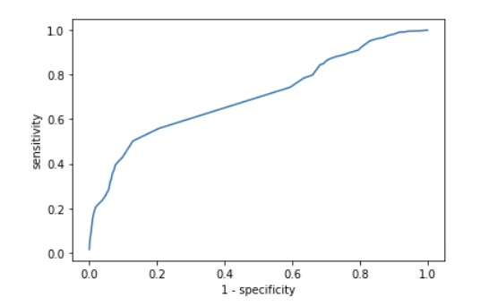
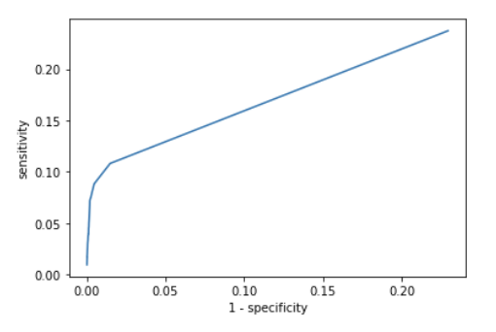
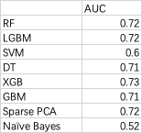
Results
Specificity = TN/N = TN/(TN+FP)
Sensitivity = TP/P = TP/(TP+FN)
Sparse PCA
Naive Bayes
*The AUC scores of baselines are condunct from Md Martuza Ahamad et.
They only consider 126 symptoms, the true value of 6725 symptoms must be
a lot less than that.
Notes:
This is the true figure. It seem that Naive Bayes model get a better specificity with 98% than Sparse PCA. however specificity is used to measure the probability that hospitalization did not occur in the result. Our aim is to extract the important features that lead to hospitalisation. So we should facous on sensitivity.
For AUC, we compared our model with other baselines and found that our sparse PCA approach still gave good results

Slide 7
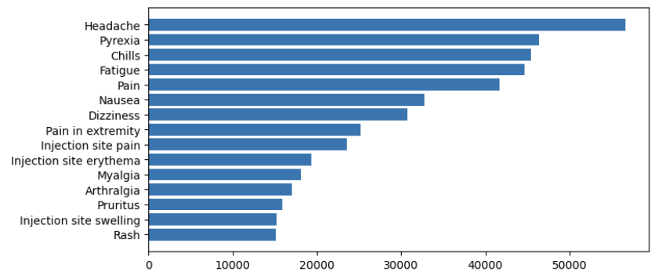
Results
Top 20 symptoms from Sparse PCA
Top 20 Symptoms from Naive Bayes
'Chills',
'Blood test',
'Pyrexia',
'Computerised tomogram', 'Unevaluable event',
'Dyspnoea',
'Pain',
'Nausea',
'Fatigue',
'Myalgia',
'Vomiting',
'Death',
'SARS-CoV-2 test negative', 'Hyperhidrosis',
'Malaise',
'Diarrhoea',
'Arthralgia',
'Pain in extremity',
'Abdominal pain',
'White blood cell count increased'
'Pyrexia',
'Pain',
'Fatigue',
'Chills',
'Headache',
'Nausea',
'Injection site pain',
'Injection site erythema',
'Pain in extremity',
'Dizziness',
'Myalgia',
'Arthralgia',
'Pruritus',
'Rash',
'Injection site swelling',
'Dyspnea',
'Injection site pruritus',
'Vomiting',
'Erythema',
'Asthenia'.
Notes:
And here are top 20 symptoms extracted from two models;
The symptoms with yellow masks are the overlapped symptoms. When we compared symptoms extracted from Naive Bayes with the most common symptoms, we can find the the symptoms are exactly the most common symptoms. Remember that our tast is to extract the most significant symptoms, so that's the reason why naive bayes model does not do well in sensitivity.

